Slide 1
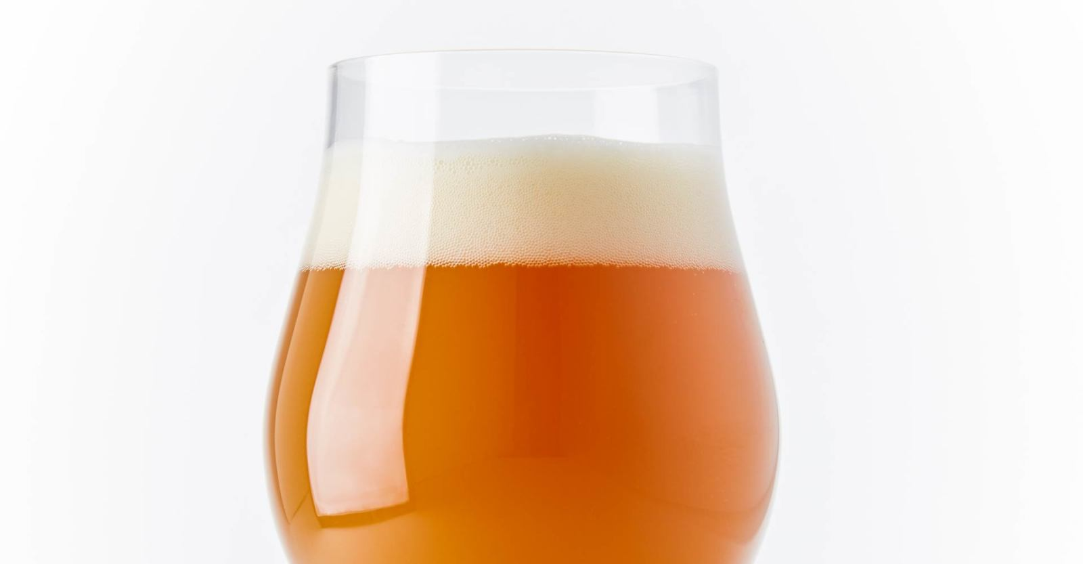
Technical Concepts Meeting-Core Style Principles of the New England Pale Ale/New England India Pale Ale
With Eric Benda
and Josh Jensen

Slide 2
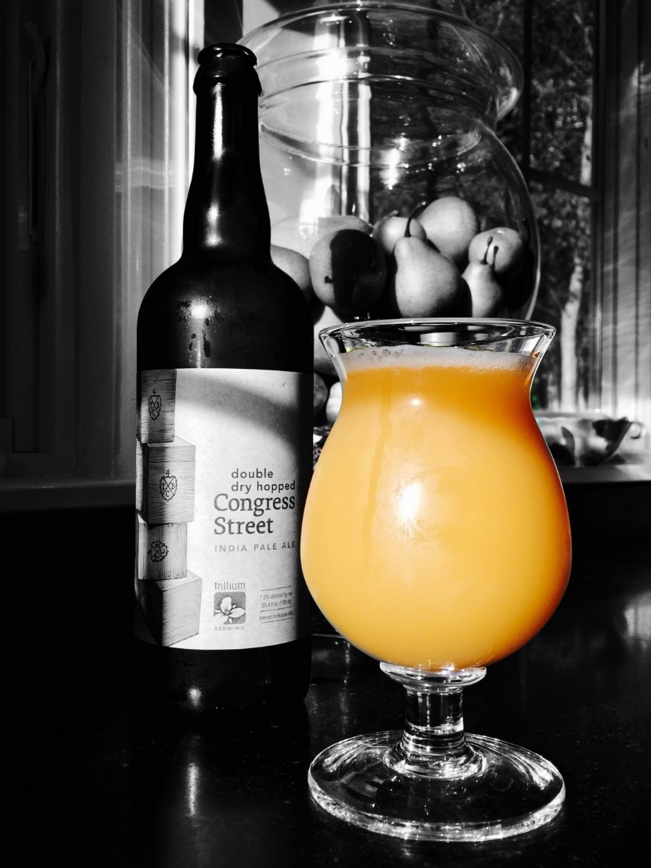
What is NE IPA?
This “style” of beer is only loosely defined, with a dynamic profile that favors a relatively subdued malt bill, fruity/juicy hops, soft water, and English-derived yeast strains.
These seem to be the only constants of the style, with obviously wide parameters in each category.
Tonight's discussion will focus on what our own research and experimentation has proven successful, and what hasn't.

Slide 3
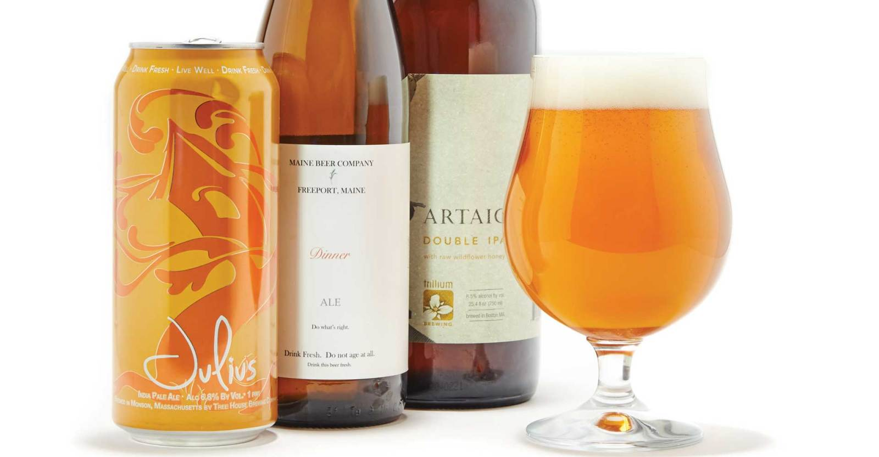
Grain Bill
Base malts with low SRM and clean flavor profiles are favored
Pale Ale Malt
Standard Two Row
Golden Promise (but consider blending with one of the previous Pale malts)
Pilsner – this is a controversial malt that came up in our discussions. There are commercial breweries and homebrewers alike using Pilsner in this style, most likely due to the SRM. Eric and I agree that due to the distinct flavor of Pilsner malt, if used at all, it should be blended, probably no more than 20-25% of base malt.

Slide 4
Adjuncts
Flaked Oats – Increase body in the beer, 5-15% of grain bill, body and mouthfeel is the goal, not “oat flavor”.
Flaked Wheat – use in combination with flaked oats, makes the beer overly messy and too “thick”, 30% flaked adjunct was the tipping point between haze/body, and messy/out of whack beer.
White Wheat – Is a key ingredient. Some commercial breweries do not use oats at all. Hard to believe they aren't using some percentage of wheat malt. 5-15% seems about right, personally favor White Wheat over oats, at a ratio of 2:1.

Slide 5
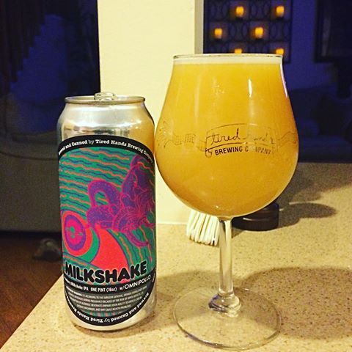
Adjuncts
Flour – DOES NOT BELONG! Yes, it has been used, but with poor result. There are other ways to achieve haze without sloppily adding adjuncts “just because”.
Dextrose – use dextrose to bump ABV and balance out the body provided by oats and wheat. Body should come from ingredients, not excess unfermented sugar.
Lactose – “Milkshake” IPA popularized by a collaboration between Tired Hands and Omnipollo brewing, originally made as a jab at the NEIPA haters, the attempt was to make a beer that was as murky and muddy as possible. A pound of lactose per five gallons really does something special for this style of beer.

Slide 6
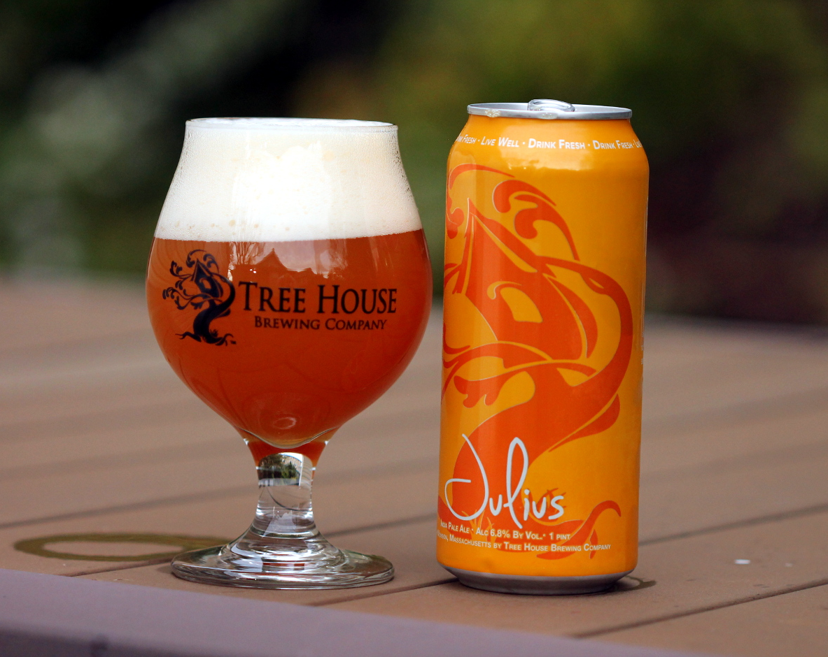
Hops
IBUs – perceived bitterness should be very low for an IPA, 30+/- IBUs not uncommon. IBU contribution coming primarily from 60 minute addition, somewhere around ½ oz, depending on the hop.
Flameout hops – Where I typically start my large additions, usually an oz. of each variety. Eric does not typically use a flameout addition. This difference seems common among commercial breweries as well. Flameout hops will have some IBU contribution due to the temperature of the wort, but significantly less than any addition added during active boiling.

Slide 7
Hops
Whirlpool hops – Both Eric and I utilize the whirlpool technique for the bulk of our kettle hop additions. I typically shoot for 4-6 oz in the whirlpool. The key to whirlpool additions is temperature. Sub-180 degrees. There are reports that state that alpha acids will isomerize above 175 degrees, and boiling hops drives off flavor and aroma. 180 degree additions have been touted in many homebrew forums, but some science says 175 is the magic number. 30 minutes is a common time limit before continuing to actively cool wort, I've heard as high as 60 minute whirlpools. This technique can be applied to a hop stand, if one did not have the necessary equipment to whirlpool their wort.

Slide 8
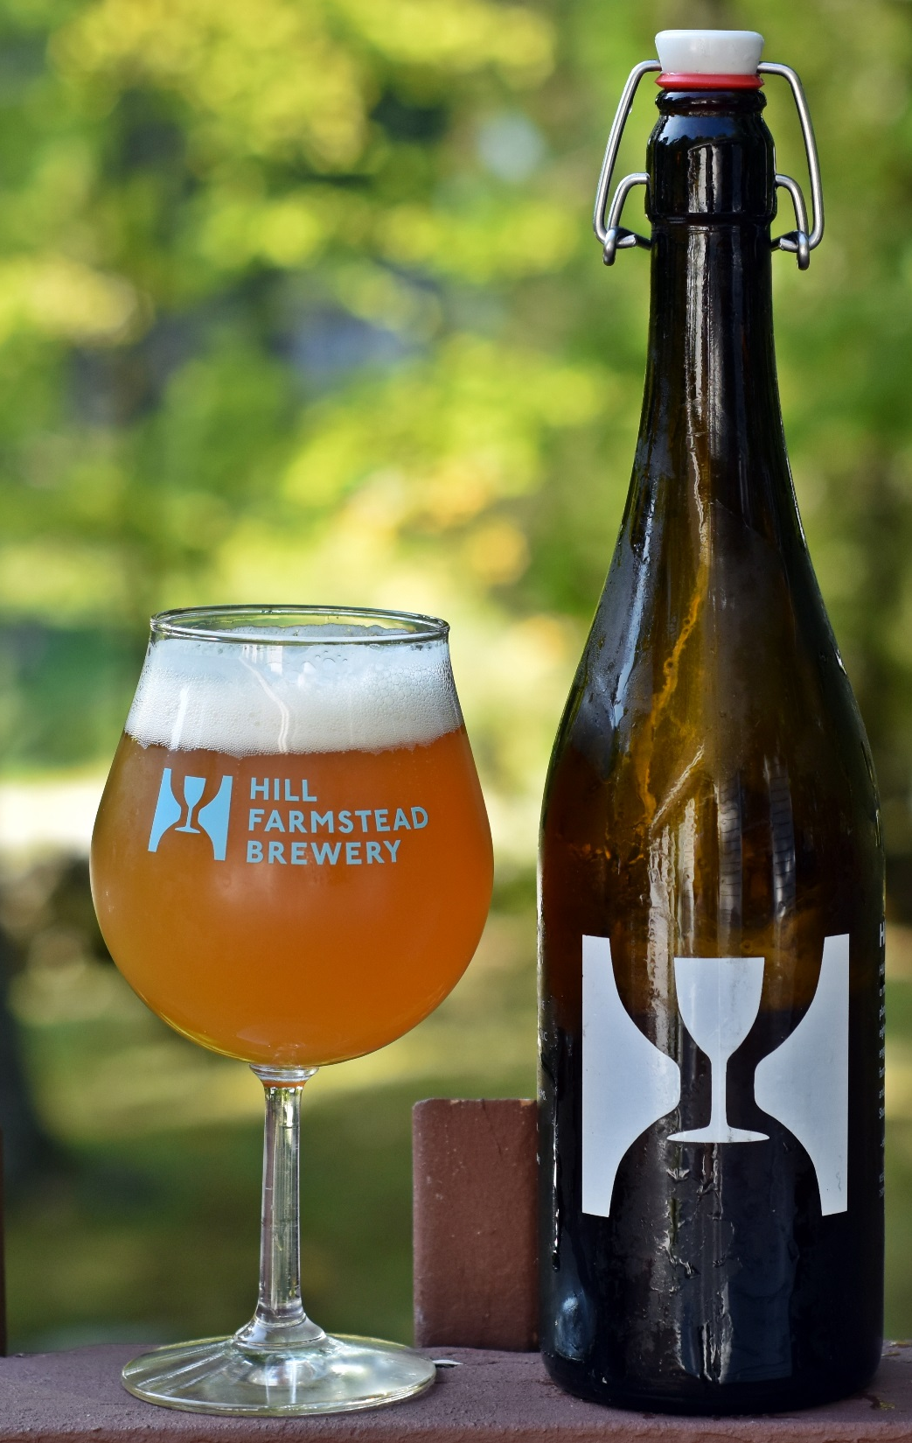
Hops
Hop Varities – Juicy, citrus forward hops are preferred in this style. Galaxy is a favorite of the NEIPA brewer. Citra, Mosaic, Vic Secret, Ella, Azzaca, 007 (Idaho 7), Mandarania Bavaria all work nicely. Piney, dank, and earthy hops don't typically appear in this style. We're not saying they won't work, and Treehouse has a beer called “Sap” that features Chinook hops, and it's delicious! It just seems that the “juice bomb” IPA is typically where folks go with this style.

Slide 9
Dry Hopping
Primary tenant is timing of the dry hop. As opposed to commonly held beliefs about dry hopping post fermentation, this style hinges on dry hopping during active fermentation.
Eric checks gravity until his beer hits 50% attenuation, and then hits the beer with dry hop number 1. If he intends on hopping a second time, he then waits until the beer is 4 points above expected terminal gravity, dry hops again, and then caps the fermenter, allowing the vessel to pressurize and retain any and all volatiles.
Less scientific approach. Monitor beer, and somewhere between 48 and 72 hours into active fermentation, high krausen is reached and the head begins to fall. When I notice the beer has reached the break over point, I dry hop.

Slide 10
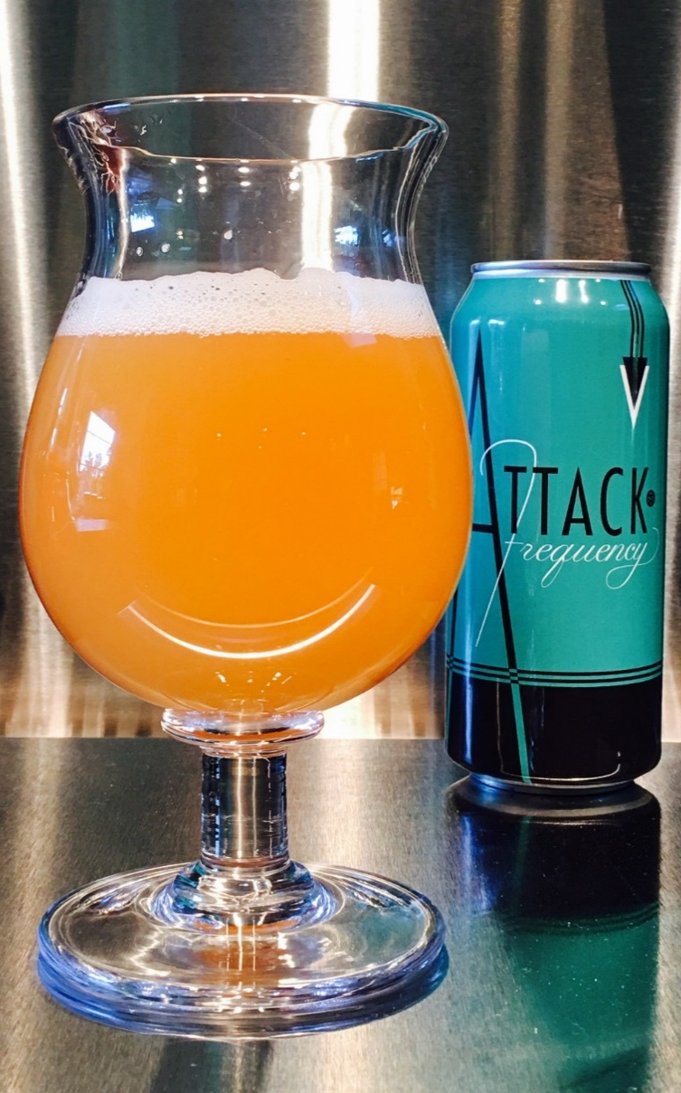
Dry Hopping
Two main reasons for hopping during active fermentation.
Oxygen scrubbing – While actively fermenting, the yeast cells should affectively scrub the oxygen trapped in the hop pellets or cones, limiting oxidation of the finished beer.
Biotransformation – Chemical modification/alteration of hop oils by the yeast cells. Assumption is scavenging of oils by yeast cells transforms the flavors of the hop oils. May be magic, and the work of the beer gods. Also potential for those hop oils that become attached to yeast cells to be more fully homogenized throughout the beer, increasing utilization overall.

Slide 11
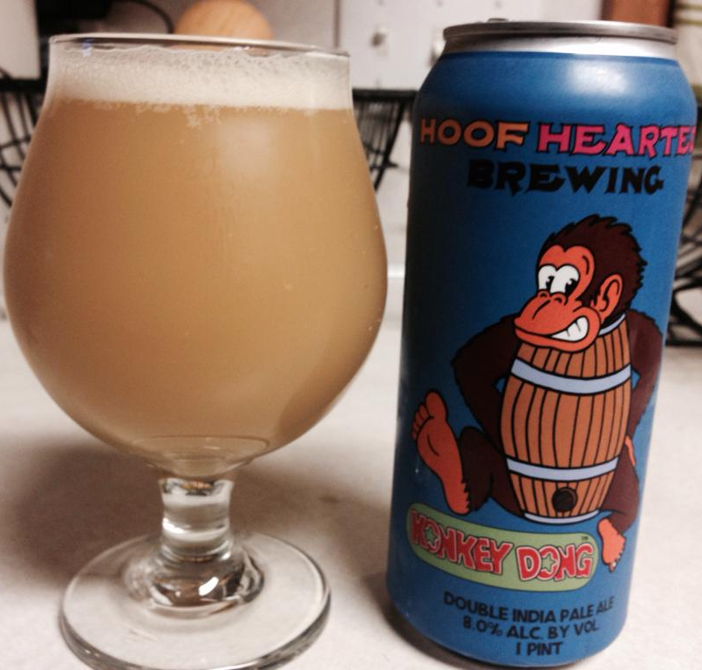
Water
Probably single biggest factor of this style.
Previous knowledge of west coast IPAs always favors sulfate over chloride. Sulfate numbers of 200-300 ppm and more are not uncommon in a west coast IPA, aimed at accentuating hop bitterness. CaCl-calcium chloride numbers would typically come in at half of the sulfate.
NEIPA seems to turn that logic 180 degrees, and basically flip those values, favoring chloride over sulfate 2:1, maybe as much as 3:1. The basic message here is that this style favors soft water, which starts with salt additions, and continues with malt bill.

Slide 12
Yeast
Handful of uber popular sac strains out there that get all the credit for making theses beers what they are. It appears that the lineage of these strains are English derived, and of course some commercial breweries have their own house yeast that is kept under lock and key.
Wyeast 1318 London Ale III. Probably the most popular amongst homebrewers for this style. An English strain, high flocculation, balances malt and hops, fruity esters, soft, balanced profile.
Conan (The Alchemist), Heady Topper Yeast. Available from a handful of yeast labs, also called Vermont Ale yeast. A notably finicky yeast, it is infamous for under attenuation. Beer lore suggests that John Kimmich typically under pitches Conan, which benefits esters, and reportedly higher attenuation (?).

Slide 13
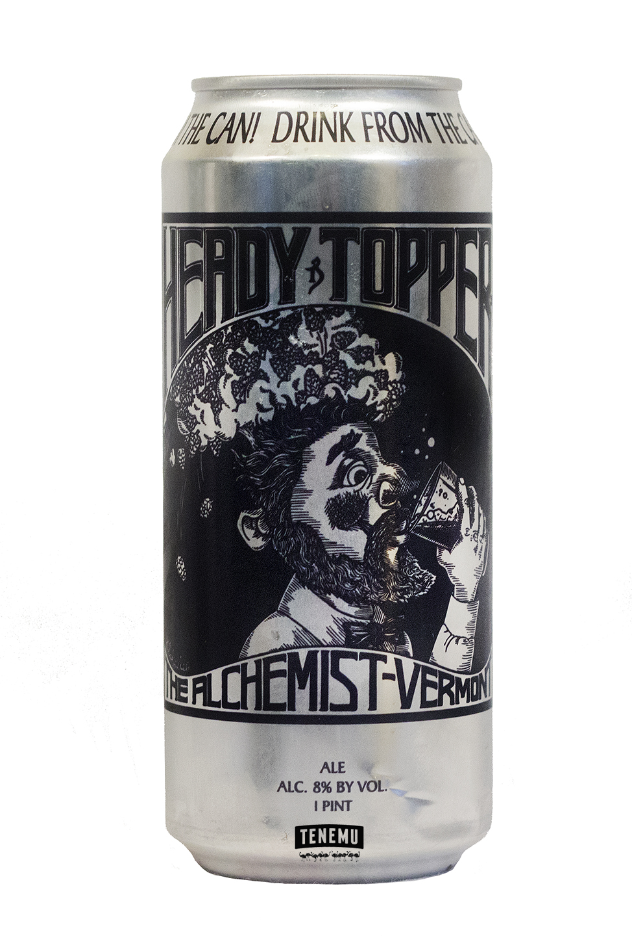
Yeast
WLP023 Burton Ale from White Labs
WLP007 Dry English Ale from White Labs
Good old Chico/001/1056-Warrant some experimentation to determine just how much of a role yeast plays in this style of beer.

Slide 14
Wrap Up
Simple malt bill with a low SRM, use either flaked adjuncts, and/or wheat malt
Primarily late hop additions and carefully timed dry hops
Soft water
English derived yeast strains that favor fruity ester production
Defeating uneducated opinions that proclaim that a hazy beer is an “unfinished” beer, with incomplete attenuation and cloying sweetness. This is simply untrue. Finished NEIPA should typically fall in the 1.010-1.015 range, with respect to adjuncts and/or lactose. ABV typically rests between 6-8%, which allows the hops to be star of the show, without being overly sessionable or imperial in nature.

Slide 15
Some Information to Check Out
BYO October 2016: The Rise of the Haze
https://beerandbrewing.com/6800447930/article/go-northeast-young-man-the-regional-juicification-of-america-s-most-popular
https://beerandbrewing.com/4060596424/article/whats-with-the-haze
https://www.homebrewersassociation.org/news/new-england-ipa-haze-craze/
https://www.homebrewersassociation.org/how-to-brew/tips-brewing-new-england-ipa/

Slide 16
Recipes
https://beerandbrewing.com/7ivI7bPWso8CUieIEiocom/article/noda-brewing-new-england-style-ipa-recipe
https://beerandbrewing.com/6llttX4yD6qKMUQgAmkg62/article/door-county-brewing-new-england-style-ipa-recipe
https://beerandbrewing.com/7FW4kwQBtmoQEuk8oU4oYG/article/weldwerks-brewing-co-juicy-bits-new-england-style-ipa

